Slide 1
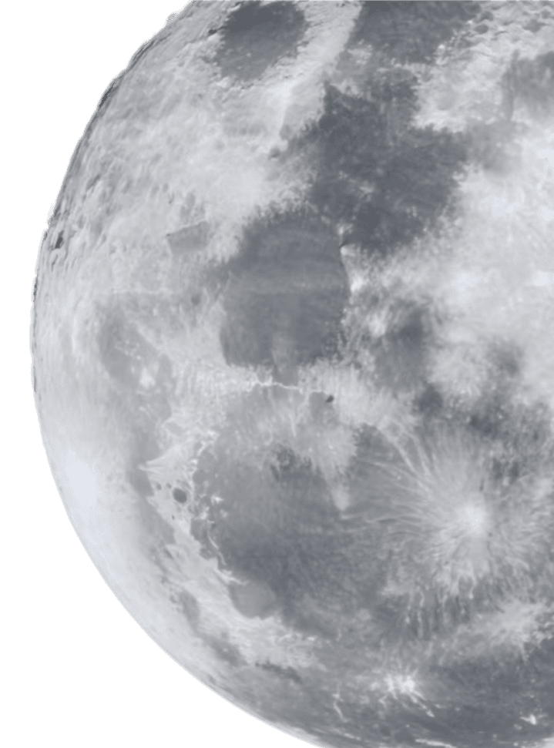
Smart Band: Run Smarter
Wu Xuechen
2025/01/01

Slide 2
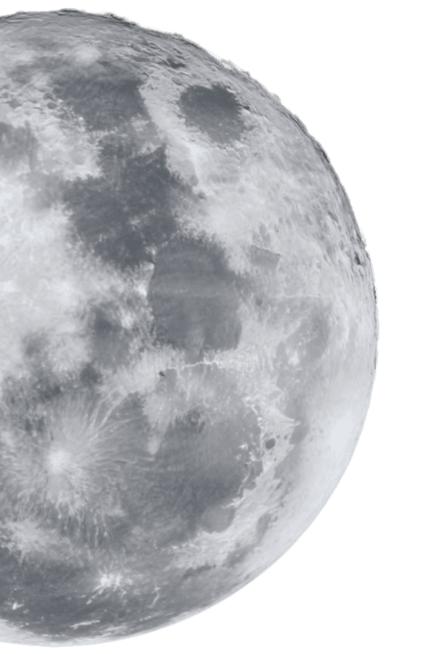
01
Core Technology
02
Performance Analytics
03
Design & Durability
CONTENTS
04
User Experience
05
Community & Motivation
06
Next Steps

Slide 3
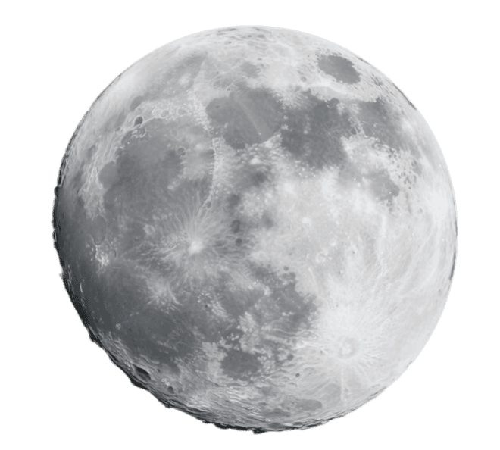
01
Core Technology

Slide 4


Embedded Sensor Technology
High-Precision MEMS Sensors
The smart band features high-precision MEMS sensors that capture 3-axis acceleration, gyroscope, and magnetometer data at 500 Hz. This ensures detailed and accurate tracking of running metrics.
Real-Time Biomechanical Feedback
The embedded sensors process raw data on-device to provide real-time feedback on stride, cadence, ground-contact time, and flight time, enhancing running efficiency without additional hardware.
Continuous Data Capture
These sensors continuously monitor and record data, ensuring that every aspect of the runner's biomechanics is captured and analyzed for optimal performance.

Slide 5


Magnetic Timing Gates
Accurate Timing with Magnetic Gates
Permanent-magnet timing gates create invisible start/finish lines with 0.01-second accuracy. The band’s magnetometer detects gate passages, ensuring precise timing in any weather.
Multi-Athlete Timing Capability
The magnetic timing gates allow simultaneous multi-athlete timing, making them ideal for group training sessions or competitive events in various weather conditions.

Slide 6

Bluetooth DX5.0 Wearables
Advanced Bluetooth DX5.0 Technology
Real-Time Data Streaming
Extended Battery Life
Seamless Integration
The DX5.0 low-energy Bluetooth 5.3 chipset offers 4× range and 2× data rate compared to previous generations, ensuring reliable connectivity.
This technology streams live stride, pace, and ground-contact analytics to the Smart Run App with sub-20 ms latency, providing instant feedback during runs.
The improved Bluetooth technology extends the smart band's battery life to 20 hours of continuous run tracking, making it suitable for long-distance runs.
The DX5.0 technology ensures seamless integration with the Smart Run App, allowing runners to access detailed analytics and insights on their performance.

Slide 7
02
Performance Analytics

Slide 8

Stride & Pace Insights
Accurate Stride and Pace Metrics
The smart band uses advanced algorithms to convert raw sensor data into stride length, cadence, and speed with ±2% accuracy, providing precise running metrics.
Real-Time Audio Cues
Runners receive instant audio cues when cadence drifts outside personalized zones, helping maintain target pace and reduce injury risk during training or races.

Slide 9

Ground Contact Analytics
Detailed Ground-Contact Metrics
The smart band calculates ground-contact time, flight time, and vertical oscillation every step, providing detailed insights into running biomechanics.
Color-Coded Feedback
Performance Improvement
Color-coded feedback highlights asymmetries or over-striding, guiding runners to make technique adjustments for improved running economy.
With guided drills based on ground-contact analytics, runners can improve their running economy by up to 5% within four weeks, enhancing overall performance.

Slide 10
03
Design & Durability

Slide 11
Weather-Resistant Surface
Durable and Weather-Resistant Design
The smart band’s outer shell is made of UV-stable thermoplastic polyurethane, rated IP68. It withstands rain, snow, dust, and extreme temperatures, ensuring reliable performance in any climate.

Slide 12
04
User Experience

Slide 13




User Interaction & Feedback
AMOLED Touchscreen
Haptic Engine
Audio Prompts
Intuitive Swipe Gestures
The smart band features a 1.1-inch AMOLED touchscreen for easy navigation and glanceable metrics, providing a user-friendly interface.
The haptic engine delivers customizable vibration alerts, ensuring runners stay informed without needing to constantly check the band.
Audio prompts via Bluetooth headphones keep runners focused on their performance, providing real-time feedback without compromising safety.
Swipe gestures allow runners to switch between real-time pace, heart rate, and power zones, making it easy to monitor different metrics during runs.

Slide 14

Smart Run App Overview
Automatic Syncing
The Smart Run App syncs automatically with the smart band post-run, displaying detailed maps, splits, and biomechanical overlays for comprehensive analysis.
Ecosystem Compatibility
The app stores unlimited history, exports data to FIT and TCX formats, and integrates with Strava, TrainingPeaks, and Apple Health for seamless ecosystem compatibility.

Slide 15


Personalized Coaching Engine
Targeted Technique Drills
The coaching engine provides technique drills targeting detected weaknesses, such as prolonged ground contact or cadence drops, to improve running form.
Adaptive Training Plans
Personalized Insights
Machine-learning models analyze past 30 days of data to generate adaptive training plans that adjust daily workouts based on sleep, HRV, and load metrics.
Runners receive personalized insights and recommendations based on their performance data, helping them optimize their training and avoid injuries.

Slide 16
05
Community & Motivation

Slide 17


Gamified Challenges
Engaging Gamified Challenges
Weekly global and local challenges award badges for streaks, distance, and technique improvements, keeping runners motivated and engaged.

Slide 18
Community Leaderboards
Real-Time Leaderboards
Privacy Controls
Real-time leaderboards rank runners by age group, distance, and skill level, fostering friendly competition and community engagement.
Privacy controls allow users to share only chosen metrics, ensuring a secure and personalized experience within the community.

Slide 19
06
Next Steps

Slide 20

Get Started Today
01
02
03
Easy Setup
Premium Coaching
Immediate Insights
Pair the smart band with the Smart Run App in under 60 seconds and complete a 5-minute baseline run for calibration to unlock personalized insights.
Early adopters receive three months of premium coaching and exclusive access to upcoming AI gait-lab features, enhancing their running experience.
Start receiving real-time feedback and personalized coaching immediately, helping runners improve their performance from day one.

Slide 21
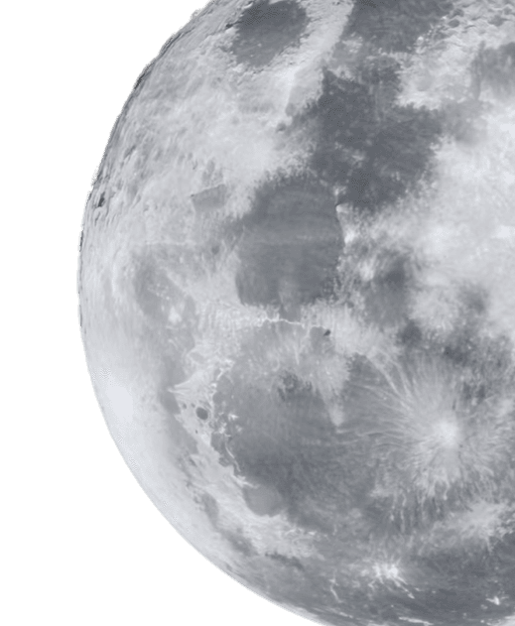
THANK YOU

